Slide 1

Stage 5 Mada Mada Course Designer: Ken Wang
Mada Mada is a 18 round, 90 point COMSTOCK MEDIUM course. There are 8 IPSC targets and 2 steel targets. The best two hits per target will score. Steel must fall to score. The start signal is audible.
The Handgun start position is standing with hands touching marks. Handgun is loaded and holstered. The PCC start position is standing with with PCC loaded, safety on, stock on belt and muzzle touching either mark.
On the audible start signal, engage all targets from within the shooting area. P1 activates dropturner DT1, which is not visible at rest. P2 activates swinger S1, which remains visible at rest.

Slide 2
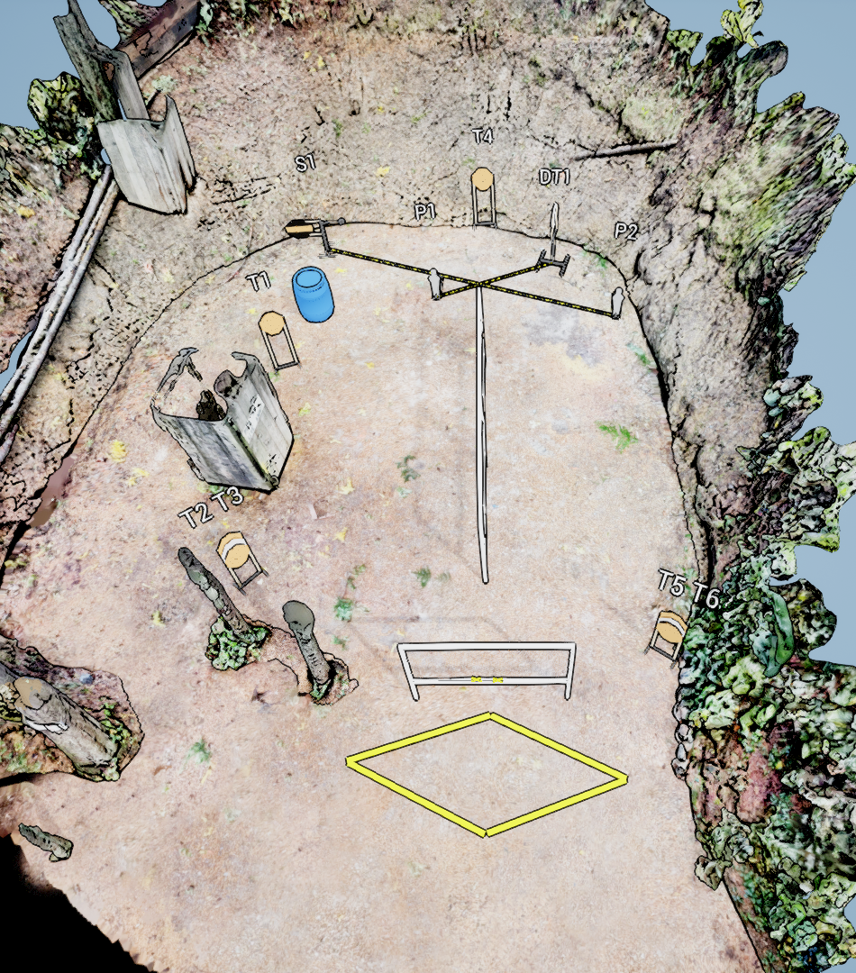
 | Stage 5 Mada Mada Course Designer: Ken Wang

